Slide 1
Where should I become a ride HAILING driver
Team Covfefe
Dan Fox, Farzad Khatoonabadi, Pravin Venkatraman

Slide 2
Agenda
Questions Asked
Demographics
Establishments
Employees
Wages
Safety
New York City
Conclusion
Terminology used in this presentation
Ride hailing – terminology used to group taxi and limousine services
Ride sharing – Terminology used to group Uber, lift, etc services

Slide 3

Questions Asked
Main Objective:
Should we start a taxi/rideshare service in San Diego, CA or Dallas, TX? The recommendation is based in terms of demand, competition, expected wage and safety.
Additional questions:
Where should I start a rideshare company? in San Diego or Dallas Counties.
What is the age of passengers?
How much money will someone make as a taxi/limo driver
Have safe is it to drive a car in San Diego or Dallas?
New York City is the modern birthplace of ride hailing services in the United States.
Why did we include this slide / data?
What does the data show on taxi usage?

Slide 4
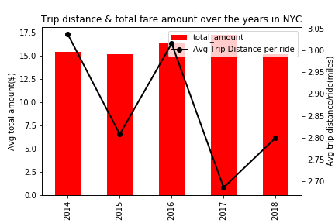
New York Taxis
Questions Asked:
Why did we include this slide / data?
What does the data show on taxi usage?
Insight:
Taxi driving is well defined and regulated in cities like New York. We collected yellow taxi data to understand recent trends in fares and miles driven. See fig below-
On an average, a taxi driver drives 3 miles and charges around $15 per trip.
source: https://opendata.cityofnewyork.us

Slide 5
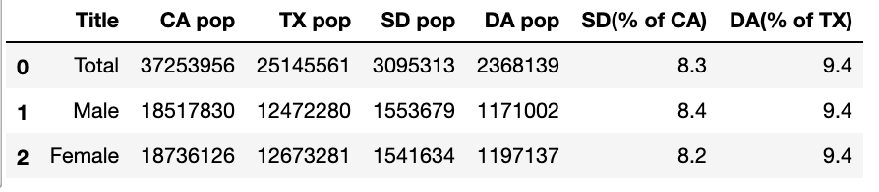
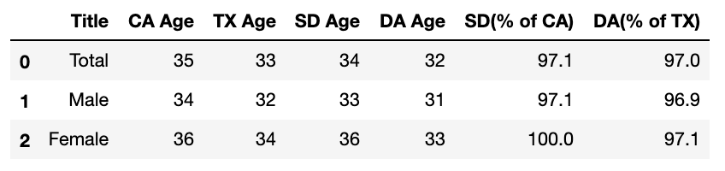
Demographics
Questions Asked:
Why we choose San Diego and Dallas?
What is the average age of the rider?
Insight
The median ages and Population of San Diego and Dallas counties, are very similar . Good for our main question.
source: https://suburbanstats.org

Slide 6
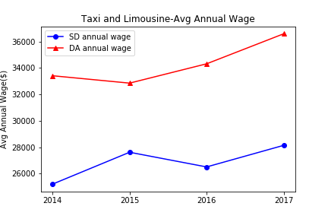
Establishments
Questions Asked:
How many companies are involved in Ride handling?
Insight
Both counties have seen a decline in the number of establishments
source: https://www.bls.gov

Slide 7
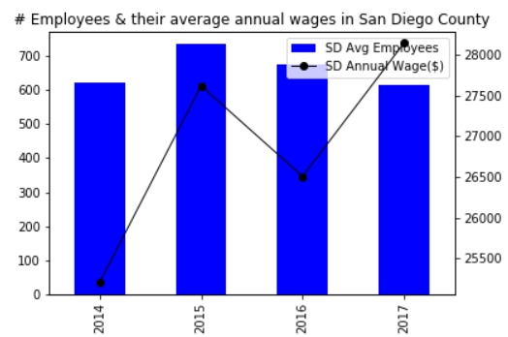
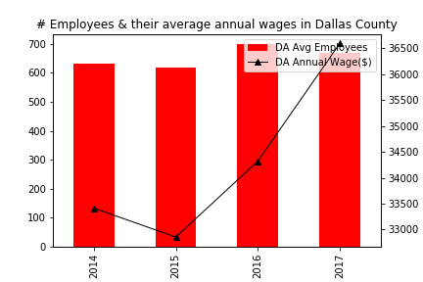
Employees and wages
Questions Asked:
How many employees work for these establishments?
How much money can you make Annually?
Insight:
Above data suggests less competition with better wages in Dallas over San Diego.
source: https://crashviewer.nhtsa.dot.gov

Slide 8
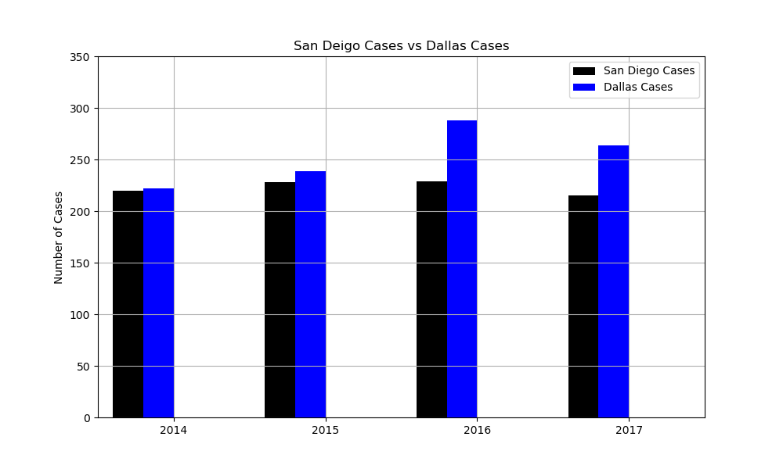
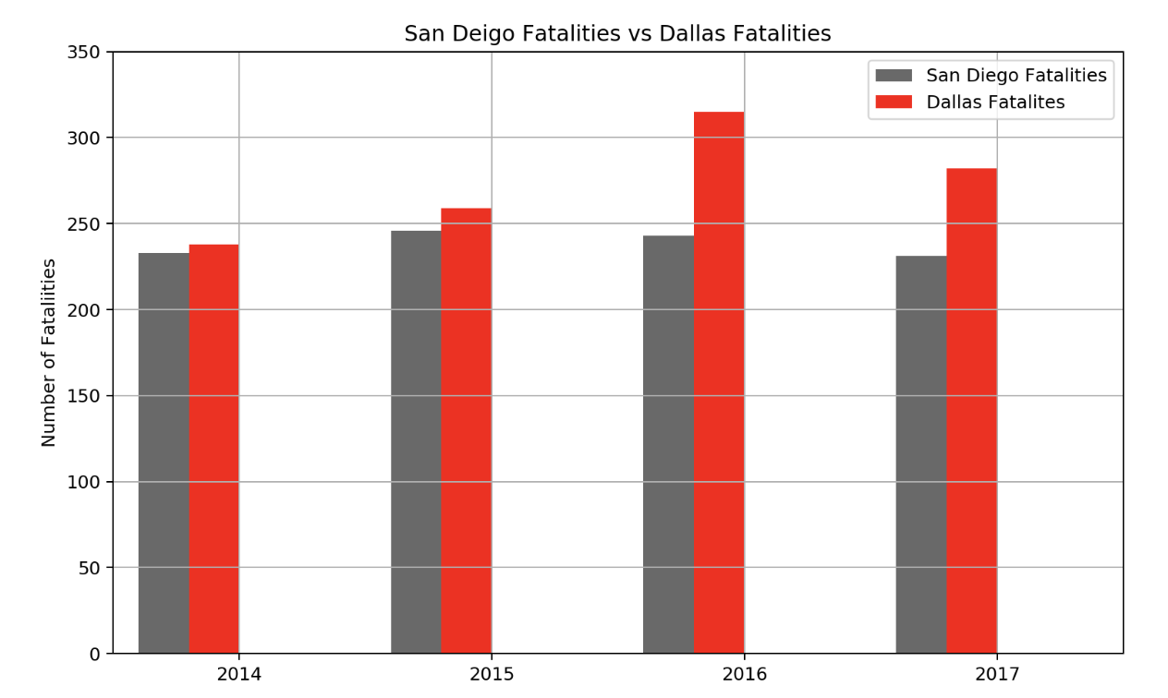
Safety
Question Asked:
How safe is it to drive a car in San Diego or Dallas?
Insight:
The number of Accidents with fatalities is trending upwards in Dallas, while San Diego’s trend is neutral.
source: https://crashviewer.nhtsa.dot.gov

Slide 9
conclusion
Based on the data, Dallas county more opportunities over San Diego County to start a ride hailing or ride sharing business on account of less competition and higher wages.

Slide 10
questions
Thank you for your time!

